Slide 1



Modal Verbs Negation
Assist. Lect. Abbas Muhsin Al-Maliki
Department of English
College of Education in Qurna

Slide 2
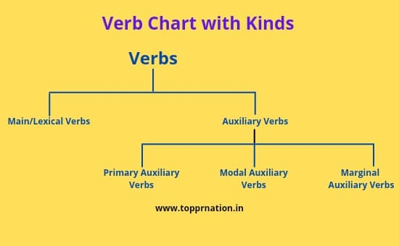
Verb Types in English

Slide 3
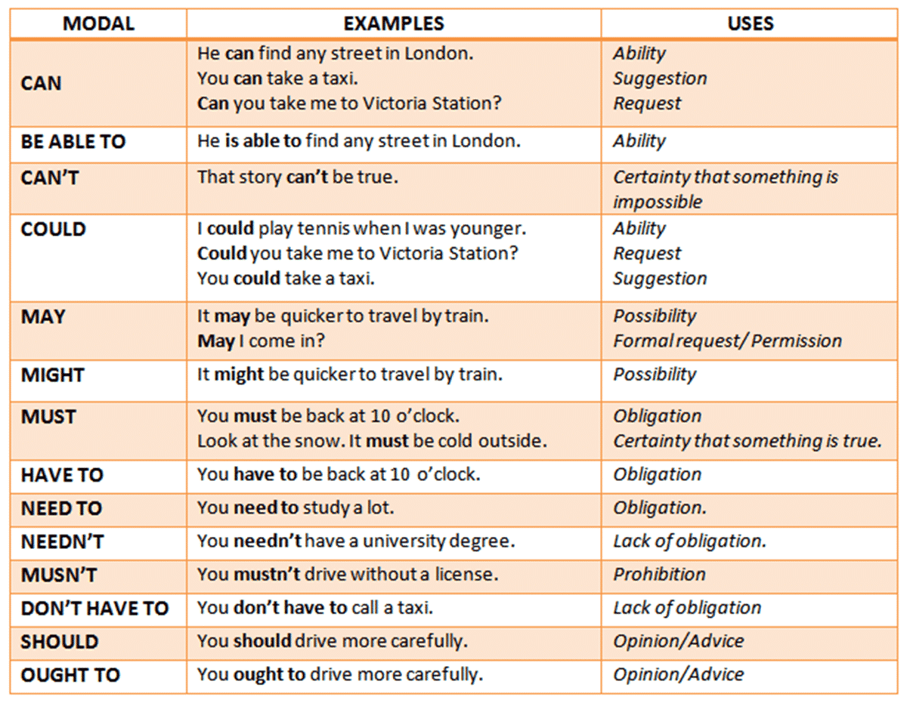
Modal Verbs in English

Slide 4
Negation of Modal Auxiliaries
The negation of the Modal Verbs may or may not include the meaning of the auxiliary itself. We therefore distinguish between AUXILIARY NEGATION and MAIN VERB NEGATION:
A. Auxiliary Negation:
may not ( = ‘permission’)
You may not go swimming (‘You are not allowed ...’)
cannot, can't (in all senses)
You can’t be serious (‘It is not possible that ...’)
You can’t go swimming (‘You are not allowed ...’)
She can’t ride a bicycle (‘She is not able to ...’)
need not, needn’t
You needn’t pay that fine (‘You are not obliged to ...’)
It needn’t always be my fault (‘It is not necessary that ...’)

Slide 5
B. MAIN VERB NEGATION :
may not (= ‘possibility’)
They may not bother to come if it’s wet (‘It is possible that they will not bother to come ...*)
--------------------------------------------------------------------------------------------------
will not, won't (all senses)
Don’t worry, I won’t interfere (‘I’m willing not to interfere’)
He won’t do what he’s told (‘He insists on not doing ...’)
They won’t have arrived yet (‘I predict that they’ve not arrived yet’)

Slide 6
B. MAIN VERB NEGATION:
shall not, shan't (all senses)
Don’t worry, you shan’t lose your reward (‘I’m willing to see that you don’t lose your reward’)
I shan’t know you when you return (‘I predict that I shall not know ...’)
---------------------------------------------------------------------------------------------------------------
must not, mustn’t ( = ‘obligation’)
You mustn’t keep us all waiting (‘You’ll oblige me by not keeping
us all waiting’)

Slide 7
B. MAIN VERB NEGATION
ought not, oughtn't (both senses)
You oughtn’t to keep us waiting (‘obligation’)
He oughtn’t to be long (‘necessity’)

Slide 8
General Notes:
Certain auxiliaries (can and need) follow the pattern of auxiliary negation.
(will, shall, must) follow that of main verb negation.
(may) belongs to the former group in its ‘permission’ sense, but to the latter group in the sense o f ‘possibility’.

Slide 9
General Notes:
(mustn’t) is not used at all(and must not only rarely) in the ‘necessity’ sense; instead, we can use can't in the sense of ‘impossibility’. Thus the negation of
You must be telling lies is You can't be telling lies.
A common auxiliary negation of must is needn't, which has the two meanings o f non-obligation and non-necessity;
A: Must we pack now? B: No, we needn’t till tomorrow.

Slide 10
General Notes:
Equivalence exists between may not (‘non-permission’) and mustn't (‘obligation-not-to’):
You may not go swimming today.
You mustn’t go swimming today.
the past tense negative auxiliaries {mightn't, couldn’t, wouldn't, shouldn't) follow the same negative pattern as their present tense equivalents.

Slide 11
Thank You &
Happy New Year 2023!

